Slide 1
Design-Pattern Project Peers Lets connect together
Presented by:
Partha Protim Paul – 2016831005
Rafiul Islam - 2016831035

Slide 2
Features we added
For Users
See all available Device’s ready to share.
Share all kinds of File among device’s.
Access other user’s File with his Permission.
Sharing from both user end using One Single Connection.

Slide 3
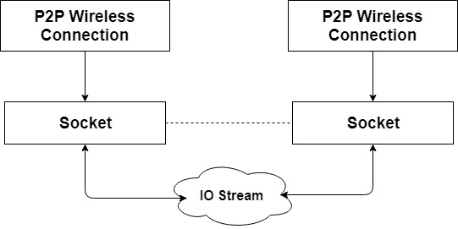
The Way we handled the Connection

Slide 4
Patterns we have used
Template
Singleton
Factory
Prototype
Iterator

Slide 5
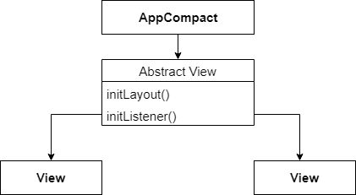
Template pattern

Slide 6
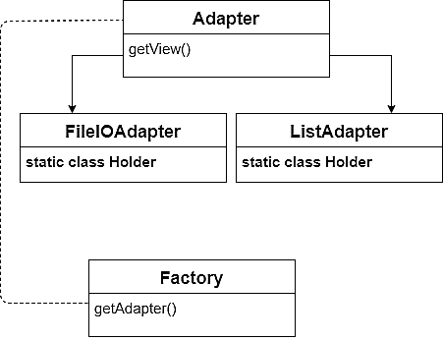
factory pattern

Slide 7
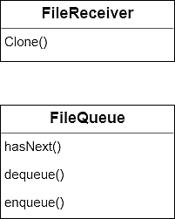
prototype and Iterator pattern

Slide 8
Thank you

